Slide 1
Threat Assessments and Attack Trees
July 2017 | You Can Do This (!)
Ben Gardiner
Principal Security Engineer, Irdeto

Slide 2
About Me
Principal Security Engineer at Irdeto
Member of the ethical hacking team
Specializing in low-level software security
>10 years of professional experience in embedded systems design
Masters of Engineering in Applied Math & Stats from Queen's University.
Member of and contributor to SAE TEVEES18A1 Cybersecurity Assurance Testing TF (drafting J3061-2)
Member of and contributor to GENIVI security subcommittee
linkedin.com/in/Ben0L0Gardiner
github.com/BenGardiner
ben.gardiner@irdeto.com
@BenLGardiner
Notes:
Just a couple things about me
I'm an ethical hacker with Irdeto
I split my time between reverse engineering and threat/risk assessments for partners in automotive.
I contribute to couple committees

Slide 3



About Irdeto
Irdeto is a pioneer in digital platform and application security.
~50 years of security expertise.
Its software security technology and cyber services:
Protect more than 5B devices & applications.
Protect against cyberattacks for some of the world’s best known brands.
Cloakware for Automotive by Irdeto helps automakers and tier-one suppliers protect their brand and save cost in the battle against cybercriminals by creating a secure, tamper-proof environment for vehicle software.
Notes:
And a little about Irdeto
We are a pioneer in digital security with roughly 50 years of security expertise.
Our software protection tools and security services protect over 5 billion devices worldwide for some of the largest brands against attacks by financially motivated attackers
Our cloakware for automotive solutions help auto makers and their tiers protect the brand against cyber criminals by creating
a secure tamper-proof env. for their software.

Slide 4
Agenda, etc.
20 minutes
Motivations: Why would I want to do this?
What are Attack Trees? What are Threat Assessments?
How can I do this?
Should I do this?
Feel free to stop me for questions at any time
Notes:
It’ll take about 20 minutes.
We’ll go over what are Attack trees? and What are the Threat Assessments and Reports that we make from them.
We’ll do attack trees first because the way we use them to model is central to the reports we generate, and they can be used also all on their own.
We'll show you how you can generate them yourself, from your own expertise.
And Should You? Yes! (glad we got that out of the way)
Please stop me for questions anytime.
Transition: So: let's start with convincing the Managers in the room (before they have too many more emails to deal with). Why is it worth the team’s time and effort?

Slide 5

Motivation: More Effective to Fix Early
Fixing Later → Overhauls
Does take time now, but could save time in the long run
And focuses efforts to areas that need it
Notes:
Doing a Threat Assessment in the design phase will increase the quality of security in the tools and solutions.
How many of you... dealt with overhauls close to release?
There are ... just easier... first time. Like sometimes fixing backdoors is like removing the floor of the house that had the backdoor.
Having ... help guide dev effrt on sec features. Otherwise ... more protections where they aren’t needed. Like a house with three deadbolts but a ladder in the side yard and the window open upstairs.
Transition: Now that you know that an Threat Assessment can save time in the long run; let’s consider the starting of one: the attack trees.

Slide 6
Attack Trees?
…?
...
...
Implant (e.g. bug)
Vandalize
Steal (e.g passport)
...
...
...
...
...
...
A model of…
the many ways to achieve a (nefarious) goal
Steal (e.g passport)
Get Inside House
Pick Locks
Victim Brings Out
Break Glass
Ladder To Window
AND
Disable Alarm (*)
Bring Ladder
Use Ladder in Side Yard
Steal (e.g passport)
Get Inside House
Victim Brings Out
AND
Disable Alarm (*)
Use Ladder in Side Yard
Bring Ladder
Ladder To Window
Break Glass
Pick Locks
Notes:
They are a way to think like an attacker. <anim>
A model of the many possible paths an attacker could take to compromise something. That something – the top of the tree is what we call an attacker objective. <anim>
The paths through the tree are the possible means that an attacker could succeed.
And when we are doing Threat Assessments, there are many of them. <anim>
<blank> A natural Q "how do I list all the attacker objectives ...?" We will ...
<unblank>
Xsition: There is some color coding here, some structure and detail. Let’s dive into the anatomy of an attack tree. We’ll look at the anatomy of that ‘steal passport’ tree in some more detail.

Slide 7
Anatomy of an Attack Tree
Steal (e.g passport)
Get Inside House
Pick Locks
Victim Brings Out
Break Glass
Ladder To Window
AND
Disable Alarm (*)
Bring Ladder
Use Ladder in Side Yard
Notes:
0 Start at one attacker objective, Focus on what can be compromised, not how it can be compromised. You can stop expanding the tree when you are into ’the how’
1 Use AND nodes to... compound ... E.g. “to get in the house I need to find the key under the door mat and find what lock it matches”
2 At the bottom: attack vector nodes
3 Out of scope nodes.
4 Reference Nodes
Most important: Att Vec Nodes. The Threat Assessment will be drafted with content based on analysis of the attack vector nodes.
Transition: So, at this point everyone is usually wondering "but how do I list the attacker objectives?" Well I'm glad you asked...

Slide 8
Attacker Objectives are…
Attacker Objectives have both:
Clear Attacker Motivations
Clear Impacts (Severities) on the Company / Org. / Stakeholders
Implant (e.g. bug)
Vandalize
Steal (e.g passport)
...
...
...
...
...
...
…?
...
...
Notes:
You’ll want to keep and list the goals that have both clear motivations for the attacker and also clear impacts on the business.
In many of the formal attack tree analyses these impacts will be modeled as severities, so listing goals at the level where the impacts are clear will help improve modelling accuracy.

Slide 9
To List Attacker Objectives…
Making a List: things an Attacker might like to do.
E.g. “Game Over”s or Attacker Money Makers
It helps to ask: ”What affects the bottom line?”
E.g. Revenue Loss, IP Theft, Brand Damage …
$$$
Revenue / Profit Loss
Brand Damage
IP Theft
Steal Passport
Vandalize
Implant (e.g. bug)
Steal Money
Notes:
Can someone tell me about some actions or goals an attacker might want to do to our poor victim’s house?
P8 Yes. All good examples.
We’re trying to list all the potential goals – things or achievements that are game over for us, and a win for the attacker.
It can often help to think about things that affect the bottom line. Take a brainstorming approach, list everything.
You want to end this excersize with a list of attacker objectives; you’ll work on expanding the attack trees under these objectives in the later phases.
<Xsition> Like any good brainstorm, you’ll probably have a mix of ideas from different contexts and different levels. You’ll want to focus on the things goals you’ve collected that have a couple key properties to make them useful attacker objectives

Slide 10

Attack Trees: What Are They Good For?
They are a Tool With Multiple Applications:
When Narrowly-Focused:
Preparing Offensive Plans (pentesting)
Considering Causes of Bugs
Brainstorming Defenses
When Broadly-Focused:
Threat Assessments
Notes:
These Attack Trees can be used for many things
You can use them in a narrow-focus to prepare offensive plans when pentesting
Or when trying to figure the cause of complex bugs, you can use attack trees to consider the multiple ways the bug behaviour can occur
Similarly, you can consider just a small part of an attack -- rooted at a technical goal instead of a higher attacker goal –
and think about possible defenses against it
Finally, when you consider all the attacks rooted in the attacker objectives we described above,
you can create a comprehensive view of threats to the system and even estimate the risks of those threats.
this is a Threat Assessment. We also call these Security Design Reviews.

Slide 11

Threat Assessments
…(revealed later)
…(revealed later)
…(revealed later)
A list of mitigations
Notes:
We will often analyse the attacker trees and report on them in the form of a Threat Assessment.
The Threat Assessments primary purpose is to give a list of mitigations, in priority order.
There are other things that the threat assessment will deliver and we’ll cover this shortly.
But this primary deliverable is an important one, because it can give you and your teamates list of security TODOs or security requirements. It can help you tackle the security issues with the biggest impact first and to not forget about the other ways that attackers might bypass your countermeasures.
<Xsition> So, I hope it’s clear why you would want one – if not, we’re not done yet and I’ll keep trying to convince you. <pause> Our experience with them has shown them to be quite valuable to design and architecture.
In fact, we’ve also found that the people we rely on to help us create the attack trees are the subject matter experts of the systems. When we’re doing one for internal or external client we’ll often spen a lot of time with these subject matter experts talking to them about the actors in their systems and the data that flows around…

Slide 12

Before you Start: Establish a Common Language
Create an Architecture Summary
Do it from your (perhaps naïve) perspective
The result will
highlight knowledge gaps and
establish a vocabulary for the Attack Trees and Threat Assessment
Capture the data flows in the system
Notes:
This is essential for the cases where the analyst is not a member of the team. But it can also be useful in the cases where the team itself is doing the analysis.
The goal of this phase is to create an architechture summary document. Not to dictate or design any part of the system, but just to capture a view of the operation of the system.
When we dive into the attack trees, we’ll need to talk about parts of the system and so we’ll need to know what to call them.
We make this architecture summary so that if we say ‘the foobar’ in the attack trees then everyone know what foobar we are talking about.
When you are drafting this architecture summary focus on the data flows in the system , that’s what the attack trees will focus on.
As I mentioned, this is critical for the case where the analyst is not a team member. For the other case, I still recommend it: it will serve as a snapshot in time of what is often a moving target: your system design and/or architechture.
If you write this down then you can refer later to the state of the architecture that led you to the conclusions in the Threat Assessment. And highlighting the changes to the architechture could inform further revisions of your Threat Assessments to iterate on an improve your defenses.
<Xsition>, at this point, you should be armed to dive into the trees

Slide 13
Generating The Trees
Implant (e.g. bug)
Vandalize
Steal (e.g passport)
One way
The Other
by X
by Y
using W
using V
…?
...
...
by Z
AND
step 1
step 2
step 3
i.e. like this
Mitigation: A
...
Mitigation: B
...
...
...
...
Do a Tree for Each Attacker Objective
Descend, descend, …
Worry about what, not how
Consult your data flows
At the bottom: ascribe ‘likelihood’ and capture all mitigations
Notes:
This is the main body of the work.
You have the starting points: the attacker objectives. Start creating the trees.
Think like an attacker. Ask yourself or your brainstorming group ”what can go wrong here?”
Remember to include estimates of difficulty and lists of mitigations on each attack vector while you have the context fresh in your mind, don’t leave that until the end.

Slide 14
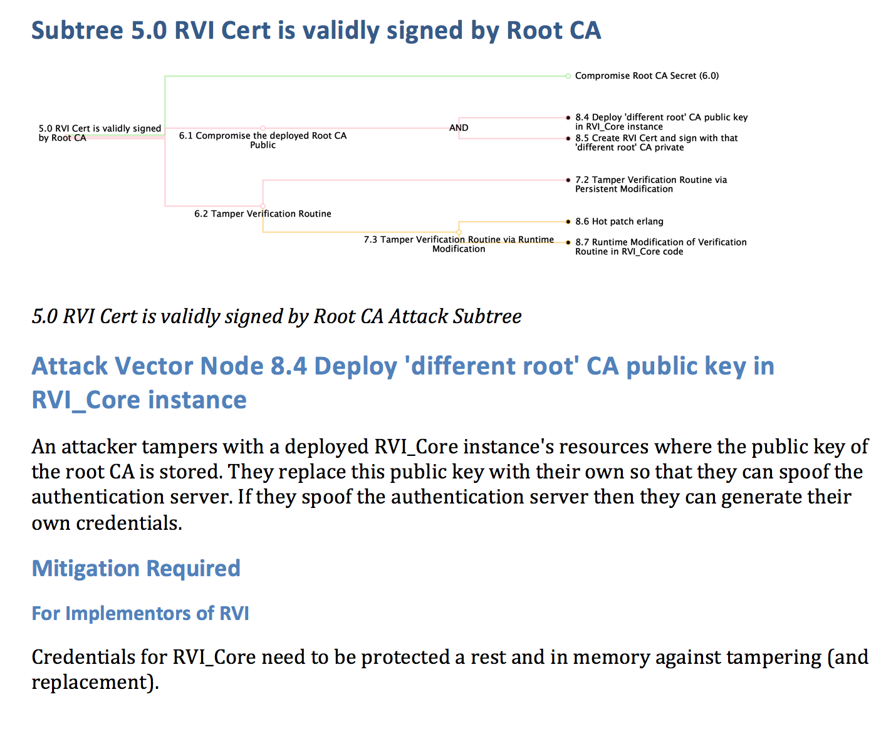

Using the Trees: Threat Assessments
A summary of all attacker objectives
A detailed look at the attack vector nodes of the trees
An analysis of risk (of the attacker objectives)
A prioritized list of mitigations
Notes:
We will often analyse the attacke trees and report on them in the form of a Threat Assessment (Threat Assessment).
The Threat Assessments primary purpose is to give a list of mitigations, in priority order. The rest of the report is there as evidence that you’ve done your homework.
The priority order of the mitigations is determined by estimating the risk of each objective.
The risk of an objective is a combination of the severity of impact if the objective is achieved by the attacker
And the probablity of attackers achieving that objective.
The rest of the report is there as evidence that you’ve done your homework.
We recommend you structre your report as follows:
List all the attacker objectives. Make sure to capture motivations and severities here.
Examine closely all the attack vectors. Make sure to capture degree of difficulty, equipment required, etc. Enough detail to provide an estimate of the probability of an this attack vector being achieved successfully. It is also a good strategy to list mitigations for the attack vectors in this context.
Analyze the probabilities of the attack vectors and combine that with the severities of the atacker objectives to estimate the risk of each attacker objective being achieved
Analyse the impact on risk of each of the mitigations and highlight the mitigations. Use this as a guide to planning your development work to secure your systems.

Slide 15
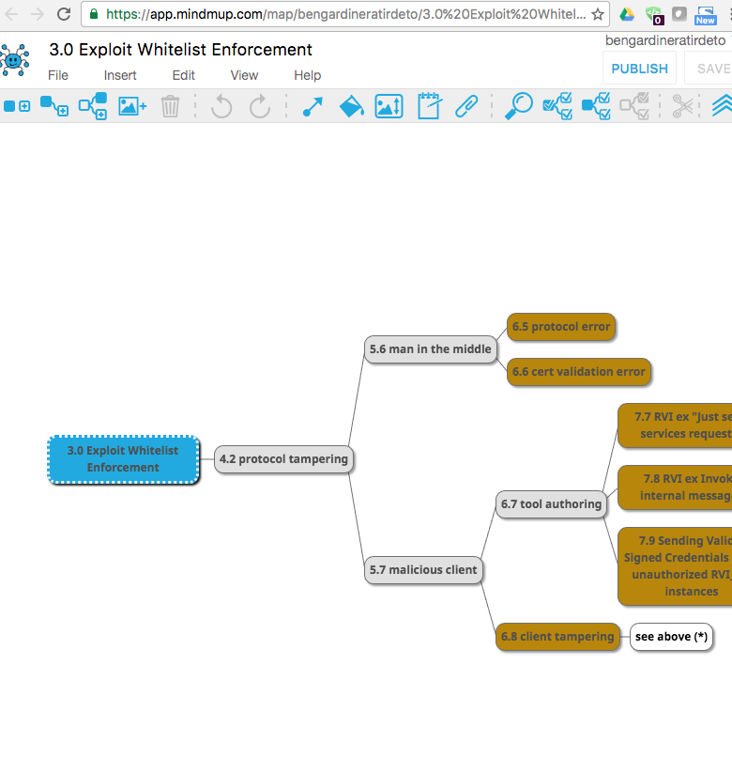
Tools For Attack Trees
$$
Word Smart-Art
Visio
Omnigraffle
Also purpose-built commercial products
Free
Graphviz DOT
Any indented text
Mindmup (e.g. at right)
Notes:
There are lots of tools…
Anything will do...
In the GENIVI security committee we using a mindmup tool and processing the JSON it saves to create reports.

Slide 16
Tools For Threat Assessments
Any Attack Tree Tool and
A means to calculate risk and generate a report
Purpose-built commercial tools
Manual: Spreadsheets and Word Processing
See also https://www.owasp.org/index.php/Application_Threat_Modeling
https://github.com/BenGardiner/mindmup-as-attack-trees
Notes:
There are lots of tools…
Anything will do...
In the GENIVI security committee we using a mindmup tool and processing the JSON it saves to create reports.

Slide 17
You Are the Subject Matter Experts
Your Domain-Specific knowledge is key
You know the data flow
Notes:
You as the designers have the experience in the system and its design to know how data flows throughout the system and hence you will have a good idea about what needs to break for other things to break.
With this knowledge, you are well-armed to make the attack tree.
With a little practice and some references, you’ll be on your way.
<Xsition> Attack trees are a tool used to explore the attack landscape, to think like an attacker and model the effects of multiple possible attacks. Often the goal of the excersize isn’t to simply list these attacks and understand them, it is to learn from them and be prepared. To do this, you will need to communicate your findings to the larger team.

Slide 18
See? You CAN do this!
Threat Assessments up-front will save time
Threat Assessments up-front will target efforts
You are the SMEs. You can do this
Your Future:
Releases with no re-designs
Threat Assessments in the design phases
Notes:
As I prepare to close…. Any Qs P8
I’m challenging you devs, to …. In your design phases
And you, the managers here – to back them up. Approve the use of time to design defenses up-front.

Slide 19

linkedin.com/in/Ben0L0Gardiner
github.com/BenGardiner
ben.gardiner@irdeto.com
@BenLGardiner

